Slide 1
IEEE Central Texas Section 2019 Fall Leadership Planning Meeting August 24, 2018 San Marcos, TX
Section Committee/Officer Name: Leslie Martinich
Chapter/Affinity Name: WIE, TEMS-Austin, EdSoc
Prepared by: Leslie Martinich

Slide 2
Vision, Leadership Team
OU Name: WIE, TEMS-Austin, EdSoc
Vision/Objectives/2019 Focused Initiatives*
Provide regular meetings to encourage membership development, and offer members value
Leadership Team
Position Name Email
Chair Leslie Martinich lmartinich@ieee.org
OU (Chapter/Affinity Group) Size and profile
Society/Affinity Group | Membership
Education Society | 19
TEMS | 47
Women in Engineering | 71
(*) These can be technical meetings, workshops, networking events, etc.

Slide 3
2019 Key Accomplishments
Meetings (month, topic, L31):
Xxxx
Date | Topic | Attendees | L31
Jan 21 | Teamwork: Collaboration & Coordination | 35 | Y
Feb 18 | Teamwork: Collaboration & Coordination II | 29
Apr 15 | Hobbies and Work-Life Balance | 12
May 20 | Handling Changes During our Careers | 18
Jun 17 | Cross Cultural Communication & Calligraphy | 22
Jul 15 | Leveraging Your Background to Further Your Career | 19
Aug 19 | Implicit Bias | 15
Date | Special Event | Attendees | L31
May 20-21 | WIE International Leadership Conference | 500

Slide 4
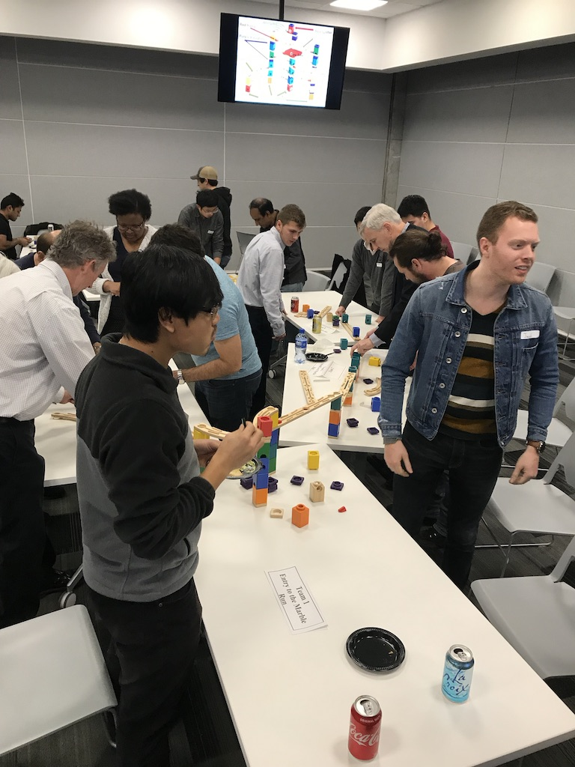

Slide 5
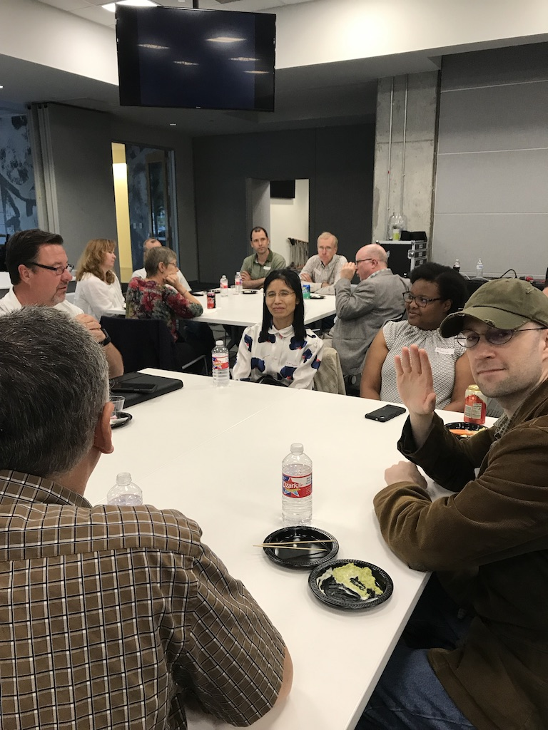

Slide 6
IEEE WIE International Leadership Conference

Slide 7
2019 Chapter Vitality & Help Needed
Chapter Vitality Assessment
Each of these chapters needs increased membership and additional volunteers.
On the positive side, we have an excellent facility (Cirrus Logic)
Another positive: attendees are now suggesting topics of interest and leading meetings
Another positive: attendees report that they got a lot of value out of meetings
Another positive: a great diverse audience
Top Help Needed/Issues
Need additional volunteers for leadership roles for each of the chapters

